Slide 1

Inheritance in Java
We introduced you to the concept of Inheritance, and showed you how to implement it in Java, using the extends keyword.
We talked about using the statement super() to call the constructor on the super class.
COMPLETE JAVA MASTERCLASS
Inheritance - Part 2

Slide 2
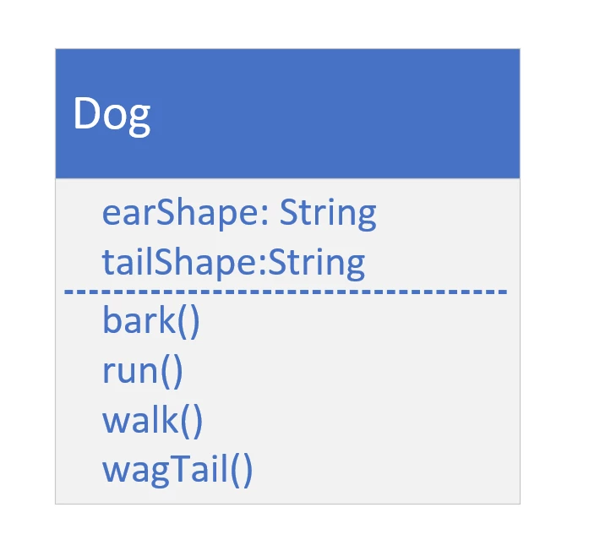
The Dog Class
COMPLETE JAVA MASTERCLASS
Inheritance - Part 2

Slide 3
Code Re-use
All subclasses can execute methods, even though the code is declared on the parent class.
The code doesn't have to be duplicated in each subclass.
We can use code, from the parent.
Or we can change that code for the subclass.
COMPLETE JAVA MASTERCLASS
Inheritance - Part 2

Slide 4
Overriding a method
Overriding a method is when you create a method on a subclass, which has the same signature as a method on a super class.
You override a parent class method, when you want the child class to show different behavior for that method.
COMPLETE JAVA MASTERCLASS
Inheritance - Part 2

Slide 5
Overridden method
The overridden method can do one of three things:
It can implement completely different behavior, overriding the behavior of the parent.
It can simply call the parent class's method, which is somewhat redundant to do.
Or the method can call the parent class's method, and include other code to run, so it can extend the functionality for the Dog, for that behavior.
COMPLETE JAVA MASTERCLASS
Inheritance - Part 2

